Slide 2
Niagara Portfolio
Brent Lowe &
Mike Westerfield

Slide 3
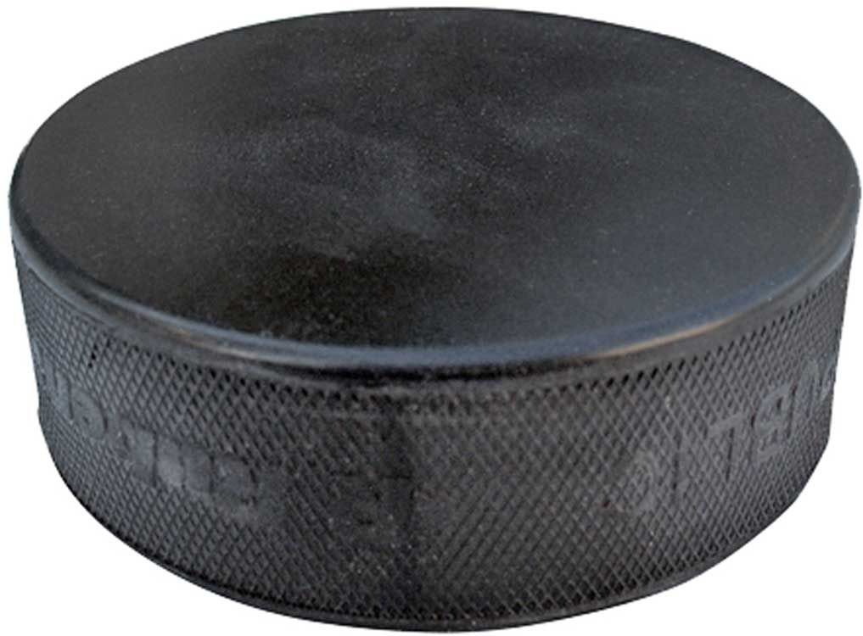
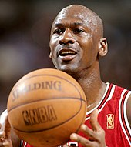
Notes:
First, I want to put something on the table.
Here are two competitive sports that require you to outscore your opponent. Both require great talent, dedication and determinism. However, I think the strategy behind these two games can be quite different.
In Basketball’s case a strong team is always a great thing. However, you can show that having a few great players on your team can be a recipe for success. For example, take Michael Jordan or Wilt Chamberlain. In the latter, Wilt once made a record for scoring 100 points in a single game. In many cases that would be a good target for the total number of points scored by the entire team in a game.
Hockey’s a little different. Sometimes a game can end with 1-0 and often does. It is not as easy to score and requires the entire team to get the puck from one end to the other. We refer to the redwings in the 50s and the oilers in the 80s as having a dynasty. In this sense, the strength of each team member is important. How bad is your worse player or weakest link is big question?
I think about the Niagara community in that same sense. The goal for Tridium is to provide you, the community, with the best framework possible. The framework is a foundation of your BAS system, and it needs to be strong.

Slide 4
Occupant experience and innovation
Notes:
So what am I talking about?
During Kevin and Jim’s keynote, they spoke about the occupant experience and innovation.
At Tridium, we are always working on making the framework better, adding extensions, removing duplicative steps and opening new doors. Some of the key areas we’ve been working on are the mobile experience, analytics, security and time savings. You’ll see these icons on subsequent slides to show you what key initiative that feature aligns with.

Slide 5
Agenda
Niagara Core
Drivers
Analytics
Hardware & New Niagara Platforms
Notes:
As we walk through our new products, hopefully you will come away excited about new opportunities to improve the occupant experience for your customers.
Although we’ve also been hard at work on new cloud offerings and enterprise security, Today we will be covering the on premise BAS experience.
This includes new Niagara builds, Analytics updates, driver availability and platforms.

Slide 6
Niagara 4.4
Legacy JACE Support
Performance Upgrades!
Single Sign On
HTML 5 Views
Notes:
Up first is Niagara 4.4.
This is our latest release, and is significant in a few key areas. Let’s take a closer look at each of these.

Slide 7
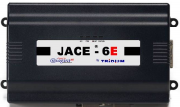
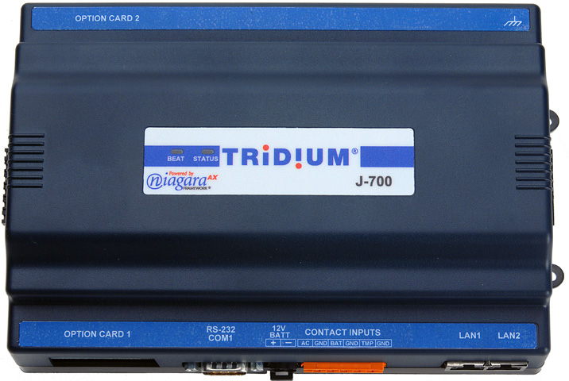
It’s been a great trip!
Long Term Supported Release
Faster Performance
Improved Memory Stability
Notes:
Oh, what a long, great trip it’s been. But, as you know, all good things must come to an end. That doesn’t mean it can’t be an easy transition though.
Niagara 4.4 is the last minor build that will support the JACE 3E, 6, 6E and 7 platforms. Don’t panic though, we’ve built better support into 4.4 and plan to back it up for some time to come. Like with AX, 4.4 will be supported with periodic builds if needed until 2021. This means these platforms will continue to get updates as needed.
On the performance front we have also been working to listen to your feedback. That means a faster UI is needed. While not restricted to the legacy platforms alone, recent optimizations have opened the door to bring page loads down. In some cases we measured 10+ second improvement.
Finally, I’d also like to say we’ve added a new algorithm to these legacy platforms that helps ensure the health of the memory. While some have experienced issues with reboots, and non-starts after reboots, this new algorithm has shown positive results in eliminating these conditions. Since these platforms will continue to run for years to come, we recommend upgrading to the latest.

Slide 8
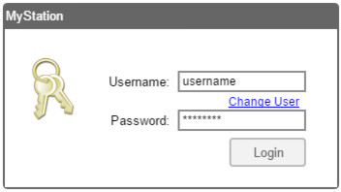
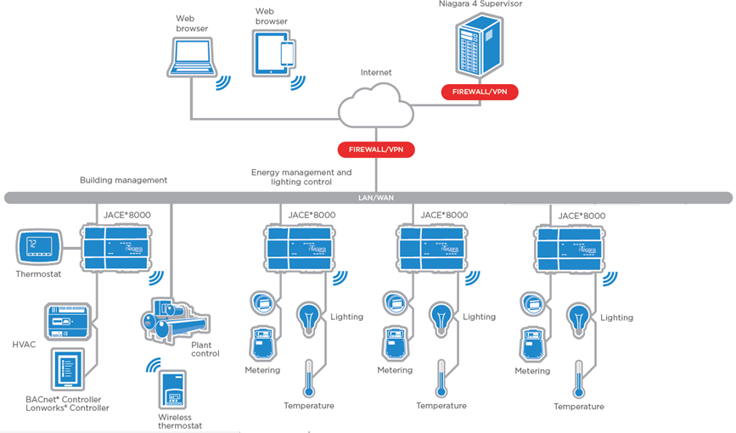
Single Sign On (SSO)
Notes:
Onto the fun stuff, let’s talk about enterprise sites with multiple JACEs. Any one familiar with a large Niagara network may have experienced the hassle of logging into to multiple JACEs and/or supervisors to navigate your system. By adopting SAML technology, each Niagara device can authenticate with a single IdP. Now you won’t have to log into multiple stations when navigating through your Niagara network. After logging into the first, the IdP will be used to authenticate each additional device. Not only is this convenient and a time saving, it also utilizes the industries best security practices. Log on and navigate your Niagara network easily and securely.
More good news is many of your sites may already have an IdP such as SalesForce, Open AM, Shibboleth, or others. So, getting started using this feature may be easier than you think.

Slide 9
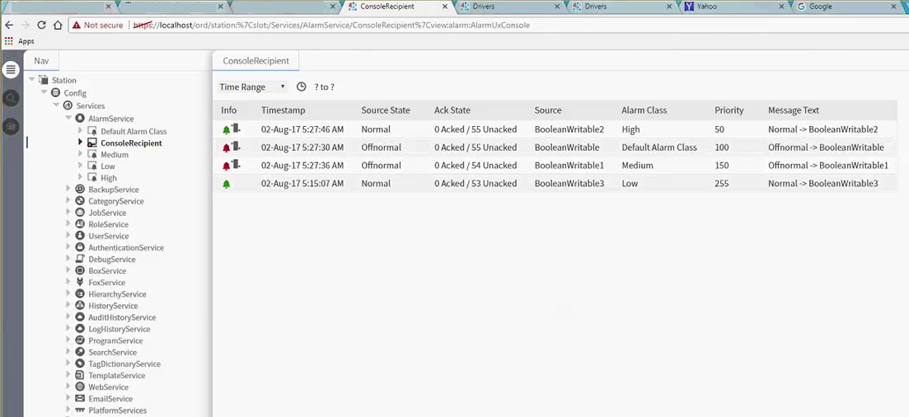
Alarm Console Update
HTML 5 Alarm console available in Niagara 4.4
Faster than Workbench in most cases
Ability to filter, acknowledge, etc…
Notes:
While we are already working on modernizing some of the more traditional workbench views, as we’ve continued working through AX migrations, 4.4 is another milestone as the major user views are now complete. Here, you can see an updated representation of the alarm console. Not only is it HTML 5 friendly, but it has the power to filter alarms, acknowledge them, and change the view by hierarchy.

Slide 10
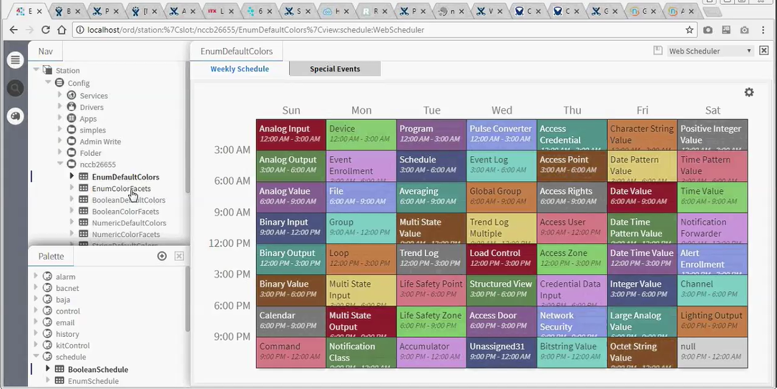
Scheduler Update
HTML 5 Scheduler available in Niagara 4.4
Support added for active dates and trigger schedules
Customized through CSS and lexicons
Notes:
The scheduler is another view updated in 4.4. While this chart looks a little busy, since it is HTML friendly, you get the sense of how customizable it is by using cascaded Style Sheets and lexicons. It is also compatible with active dates to quickly help you visualize reoccurring events. You can also use this new view to setup trigger schedules.

Slide 11
New Drivers
Notes:
Drivers are another key enabler for the community. As the smart building and facility continue to evolve, we love getting requests to connect new systems and devices that can be better optimized with Niagara.

Slide 12
All new connectivity!
BAS:
BACnet BTL AWS w/ 4.3
IoT:
MQTT
Industrial:
OPC-UA
Ethernet/IP
Profinet
Niagara Marketplace
Notes:
As you might expect, Bacnet continues to be an important driver for the community. As such, we are happy to announce that 4.3 is now Advanced Work Station certified. A few of you may run into this spec in NA, but many of you do in Europe. BC testing is still underway and expected to be available in a few months.
MQTT –was released in Q4 last year and is a Lightweight publish/subscribe messaging transport. As we see more excitement in the IoT space, we believe this protocol will help pull information in from tomorrow’s smart sensors.
Another key area we see more requests for connectivity is industrial systems. In many cases, we are finding a wealth of information and data on the production plant floor. Often managed by simple spreadsheets and daily manual data pulls, there are plenty of opportunities to talk with the industrial plant you are serving and help them visualize the data out of their production floor. Think of the possibilities of offering greater insight into how efficient each line is and which shift has the highest production or most number of line down events? The following three drivers can help you tap into that data.
OPC-UA- Is a Machine to Machine communication protocol for industrial automation. It was released in Q4 last year.
Example: PLCs
Building on OPC-UA, we have two more drivers focused on Industrial data integration. Ethernet/IP or Ethernet Industrial Protocol and Profinet. (Siemens)
While we are still working on these two, they are close to release. Come talk to us about Beta if interested in Ethernet/IP or Profinet.
Finally, it’s not just about what we’ve developed, but what you’ve been working on too. The Niagara Marketplace is a great way to see what other drivers are available from the community. I’m aware of atleast a few new community developed drivers which offer connectivity to Maximo, Trirega and even VRF systems.

Slide 13
Analytics
2.1
Notes:
While connectivity and data gathering is an important attribute. Detailed data analysis, and actionable insight is the key for tomorrow. We believe Analytics is a natural extension of the framework. We have been working steadily to expand the Niagara Analytic Framework. While some of you may be aware of the current 2.0 release and it’s ability to deploy standard to rules to pre tagged data points, we have some exciting new features in the upcoming 2.1 release.

Slide 14
Niagara Analytics 2.1 Features
7 New Reports
Spectrum
Relative Contribution
Load Duration
Average Profile
Improved Analytic Webcharts with configurable options
More public APIs/Ord-schemes for Adhoc queries & extensibility
Data normalization based on area, degree days
Visualize baseline data in chart for easy comparisons
More intelligence to alerts by utilizing equipment relations
Aggregation
Ranking
Equipment Operation
Notes:
In the upcoming release we have added additional reports, improved webcharts and added new APIs.
This means you will get new visual insight into your building. Being able to easily normalize energy consumption by area, degree day and schedule will uncover new areas of focus.
As metadata and tagging adoption continues, the analytics framework will open a new application layer to the community. Imagine being able to easily download and deploy a new chiller optimization routine from the cloud, finding it only minutes earlier on the Niagara Marketplace.
2.1 will be released in a just a few months and Tridium is now looking for beta customers.
Now let’s take a closer look at the new reports available.

Slide 15
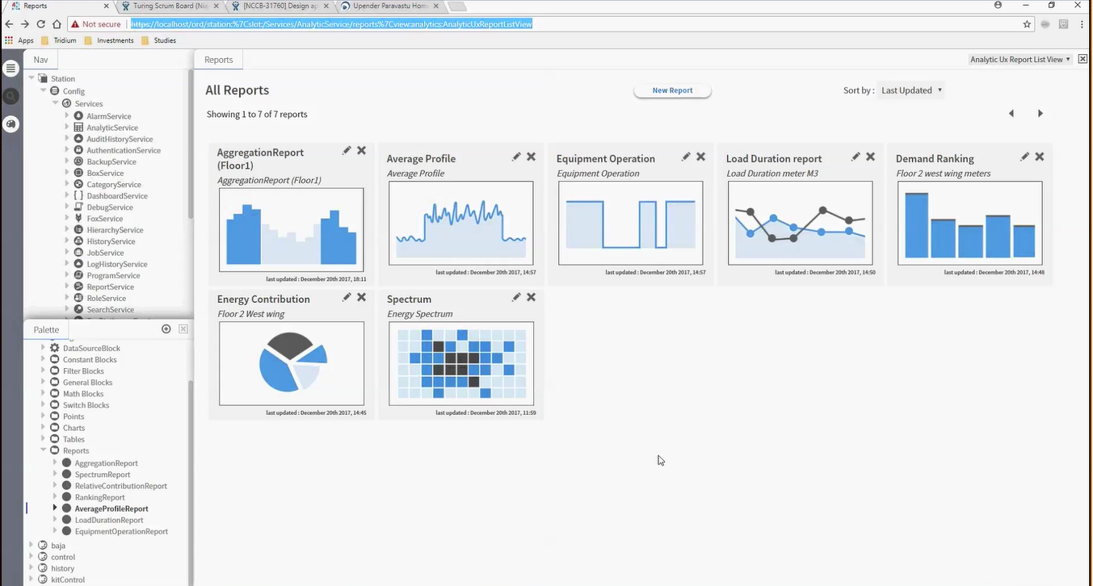
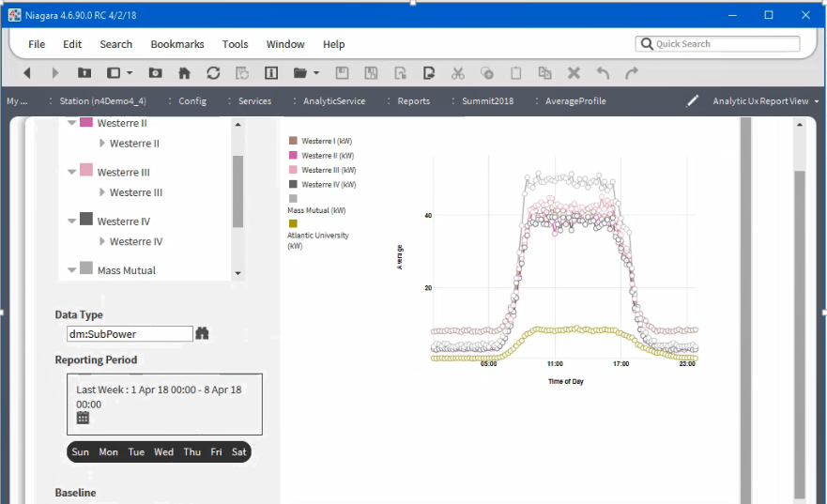
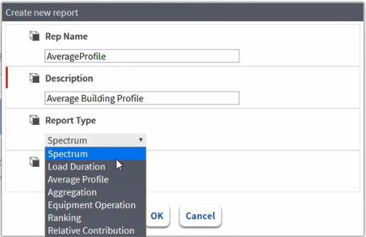
New Reports
Notes:
Seven new webcharts are now offered. These include a spectrum analysis, load duration, average profile, aggregation, equipment operation, ranking and relative contribution. From the workflow above, simply start by choosing “new report”, Next, simply drag and drop hierarchies from the nav tree. With this simple approach, it’s possible for anyone to generate an analytic report.
Let’s take a look at what a few of the seven new reports look like, and why they are valuable.

Slide 16
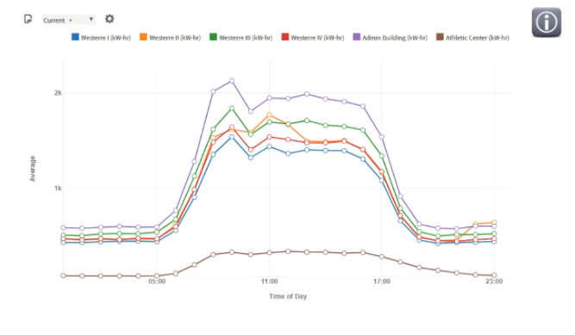
Analytics 2.1 – Average Profile
Notes:
After dragging a few hierarchies from the tree, an average report can be used to overlay multiple different facilities consumption data and compare. While this was possible before, these charts can now be created faster. In addition, total consumption doesn’t always tell the whole story, so the next bit of insight comes when reanalyzing this information by area. While total consumption might show what looks to be consistency, area can help normalize in a new way and tell a different story.

Slide 17
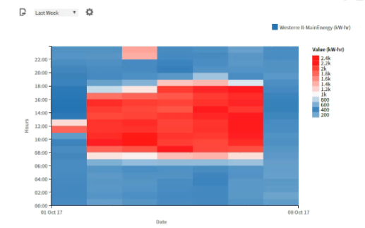
Analytics 2.1 – Spectrum Analysis
Notes:
In the chart above, energy consumption is overlaid on top of a schedule. When contrasting colors are used, a typical pattern starts to emerge in a seven day week. As expected, Monday through Friday, energy usage is higher during normal work hours. But, what’s happening early in the morning Tuesday and mid day Sunday? This is something that might not have been something easily observable before.

Slide 18
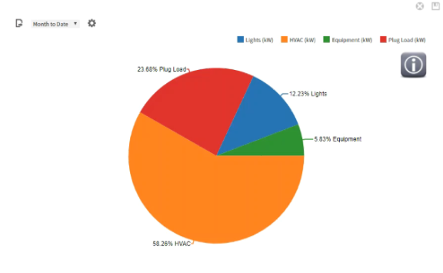
Analytics 2.1 – Relative Contribution
Notes:
The last new chart seen here is about relative contribution. Perhaps you are curious about what energy sources are being consumed most. It’s also possible to look at other groupings such as tenants. This is a valuable tool when trying to segregate different consumers.
While this is only three of the new charts, I encourage you to stop by the booth and see the other new features of Niagara Analytics 2.0 and 2.1.
Stay tuned though, as we are continuing to add more features. In our next revision we are looking to add capabilities with Correlation, Forecasting and Data cleansing
We’ll also be adding Dashboard widgets (HTML 5 based), Alert dashboard and Advanced layout support

Slide 19
Niagara 4.6
New Mobile Experience!
System Database
FIPS 140-2
Template Deployment
Certificate Management
Notes:
Back to core Niagara, let’s now look at 4.6. Like 4.4 this has a lot to be excited about. As Kevin already showed in the key note, we’ve focused on the complete occupant experience.
As you gaze upon the next few slides, the 4.6 release is nearly here. We are just kicking off a beta outreach, so be sure to stop by the booth, get a look, and let us know if you have a site in mind. Let’s take a look at the highlights…

Slide 20
Notes:
Dating back to 3.7, we added a “new” mobile profile. There was only one problem. In many cases, two views had to be designed to accommodate different display types. Challenges existed as mobile device were adopted. How were you supposed to have a single screen layout that worked for a desktop and small mobile phone? Some large graphics couldn’t easily scale, touch actions couldn’t be evoked, how were you supposed to deal with keyboards popping up?
In 4.6, we’ve completed overhauled the HX profile, and adopted a “mobile first” mentality.

Slide 21
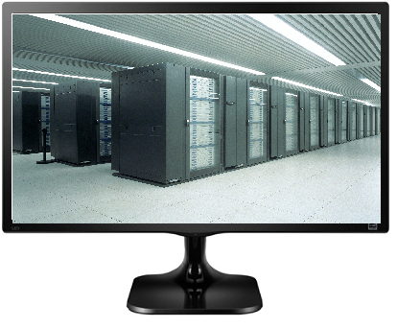
Challenges with Mobile?
Notes:
Dating back to 3.7, we added a “new” mobile profile. There was only one problem. In many cases, two views had to be designed to accommodate different display types. Challenges existed as mobile device were adopted. How were you supposed to have a single screen layout that worked for a desktop and small mobile phone? Some large graphics couldn’t easily scale, touch actions couldn’t be evoked, how were you supposed to deal with keyboards popping up?
In 4.6, we’ve completed overhauled the HX profile, and adopted a “mobile first” mentality.

Slide 22
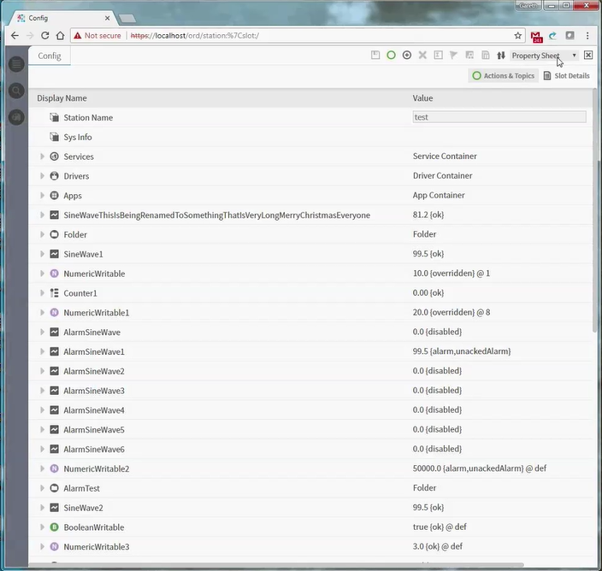
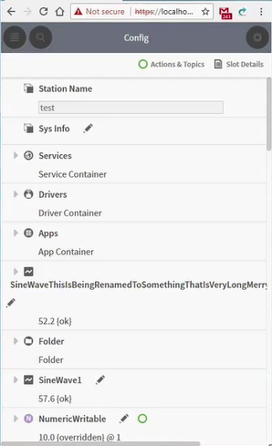
Navigation & Tools pane
Screen real estate is optimized based on total resolution
Notes:
We started by making sure basic page elements like the Nav tree, search bar, icons and now commands respond appropriately. By setting up progressive points based on resolution, certain navigational, tool bar and more would dynamically change to optimize real estate.

Slide 23
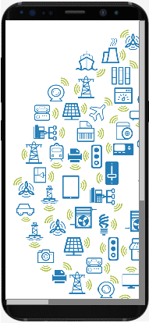
Page Content
New limits for image scaling and scrolling
Notes:
Next, we setup scaling limits so common gestures like pinch to zoom are useful.
Next we came up with new filters that could be used. For example, being able to apply a hybrid canvas and scroll pane to a view. When sizing a large graphic, the fit to ratio option could be set with limits when reducing screen size from a 4k display down to a phone, once the minimum size limit was reached, only then would the scroll pane appear. While this change is simple, it allows for much more flexibility than before.

Slide 24
Page Content
New limits for image scaling and scrolling
Notes:
Next, we setup scaling limits so common gestures like pinch to zoom are useful.
Next we came up with new filters that could be used. For example, being able to apply a hybrid canvas and scroll pane to a view. When sizing a large graphic, the fit to ratio option could be set with limits when reducing screen size from a 4k display down to a phone, once the minimum size limit was reached, only then would the scroll pane appear. While this change is simple, it allows for much more flexibility than before.

Slide 25
Page Layout
1
1
Landscape or Portrait?
Use Flow Pane
2
3
4
5
2
3
4
5
Notes:
Finally, for each of these new settings, we provide a filter. In 4.6, these are on by default, to save you time when upgrading. They can be disabled on a page by page basis if desired.

Slide 26
New Mobile Enhancements
Scaling Screen size
List of views?
Property Sheet, Scheduling and Alarming
HTML5 HX profile is now mobile friendly
Navigation Widgets
Extended features
Example Screenshots?
Hit a demo site?
Notes:
Dating back to 3.7, we added a “new” mobile profile. There was only one problem. In many cases, two views had to be designed to accommodate different display types. Challenges existed as mobile device were adopted. How were you supposed to have a single screen layout that worked for a desktop and small mobile phone? Some large graphics couldn’t easily scale, touch actions couldn’t be evoked, how were you supposed to deal with keyboards popping up?
In 4.6, we’ve completed overhauled the HX profile, and adopted a “mobile first” mentality.

Slide 27
New Mobile Enhancements
Scaling Screen size
List of views?
Property Sheet, Scheduling and Alarming
HTML5 HX profile is now mobile friendly
Navigation Widgets
Extended features
Example Screenshots?
Hit a demo site?
Notes:
We started by making sure basic page elements like the Nav tree, search bar, icons and now commands respond appropriately. By setting up progressive points based on resolution, certain navigational, tool bar and more would dynamically change to optimize real estate.
Next, we setup scaling limits so common gestures like pinch to zoom are useful.
Next we came up with new filters that could be used. For example, being able to apply a hybrid canvas and scroll pane to a view. When sizing a large graphic, the fit to ratio option could be set with limits when reducing screen size from a 4k display down to a phone, once the minimum size limit was reached, only then would the scroll pane appear. While this change is simple, it allows for much more flexibility than before.
Finally, for each of these new settings, we provide a filter. In 4.6, these are on by default, to save you time when upgrading. They can be disabled on a page by page basis if desired.

Slide 28
Smarter Supervisor?
Why do I have to integrate twice?
Notes:
Our next big development was mapped out after taking a hard look at supervisor construction. In 4.0 we introduced tagging and templating. This paved the way for use of metadata inside the building, and templates allow us to do this consistently.
Still, to build a system it still starts with integrating devices into the JACE, then integrating JACEs into the Supervisor. If only there was a better way?

Slide 29
GoogleBot?
Notes:
Some of you are aware of the small start up called google. They had a great idea to build a search engine that could easily find what you are looking for.
Examples of searches?
Best bar in New Orleans?
Best drink on bourbon street?
Best hangover cure?
How did I get all these beeds?
Sure!
In any case, this is made possible in part by googlebot. Periodically, the web is searched and a database is continuously updated. It knows what you want before you want it!

Slide 30
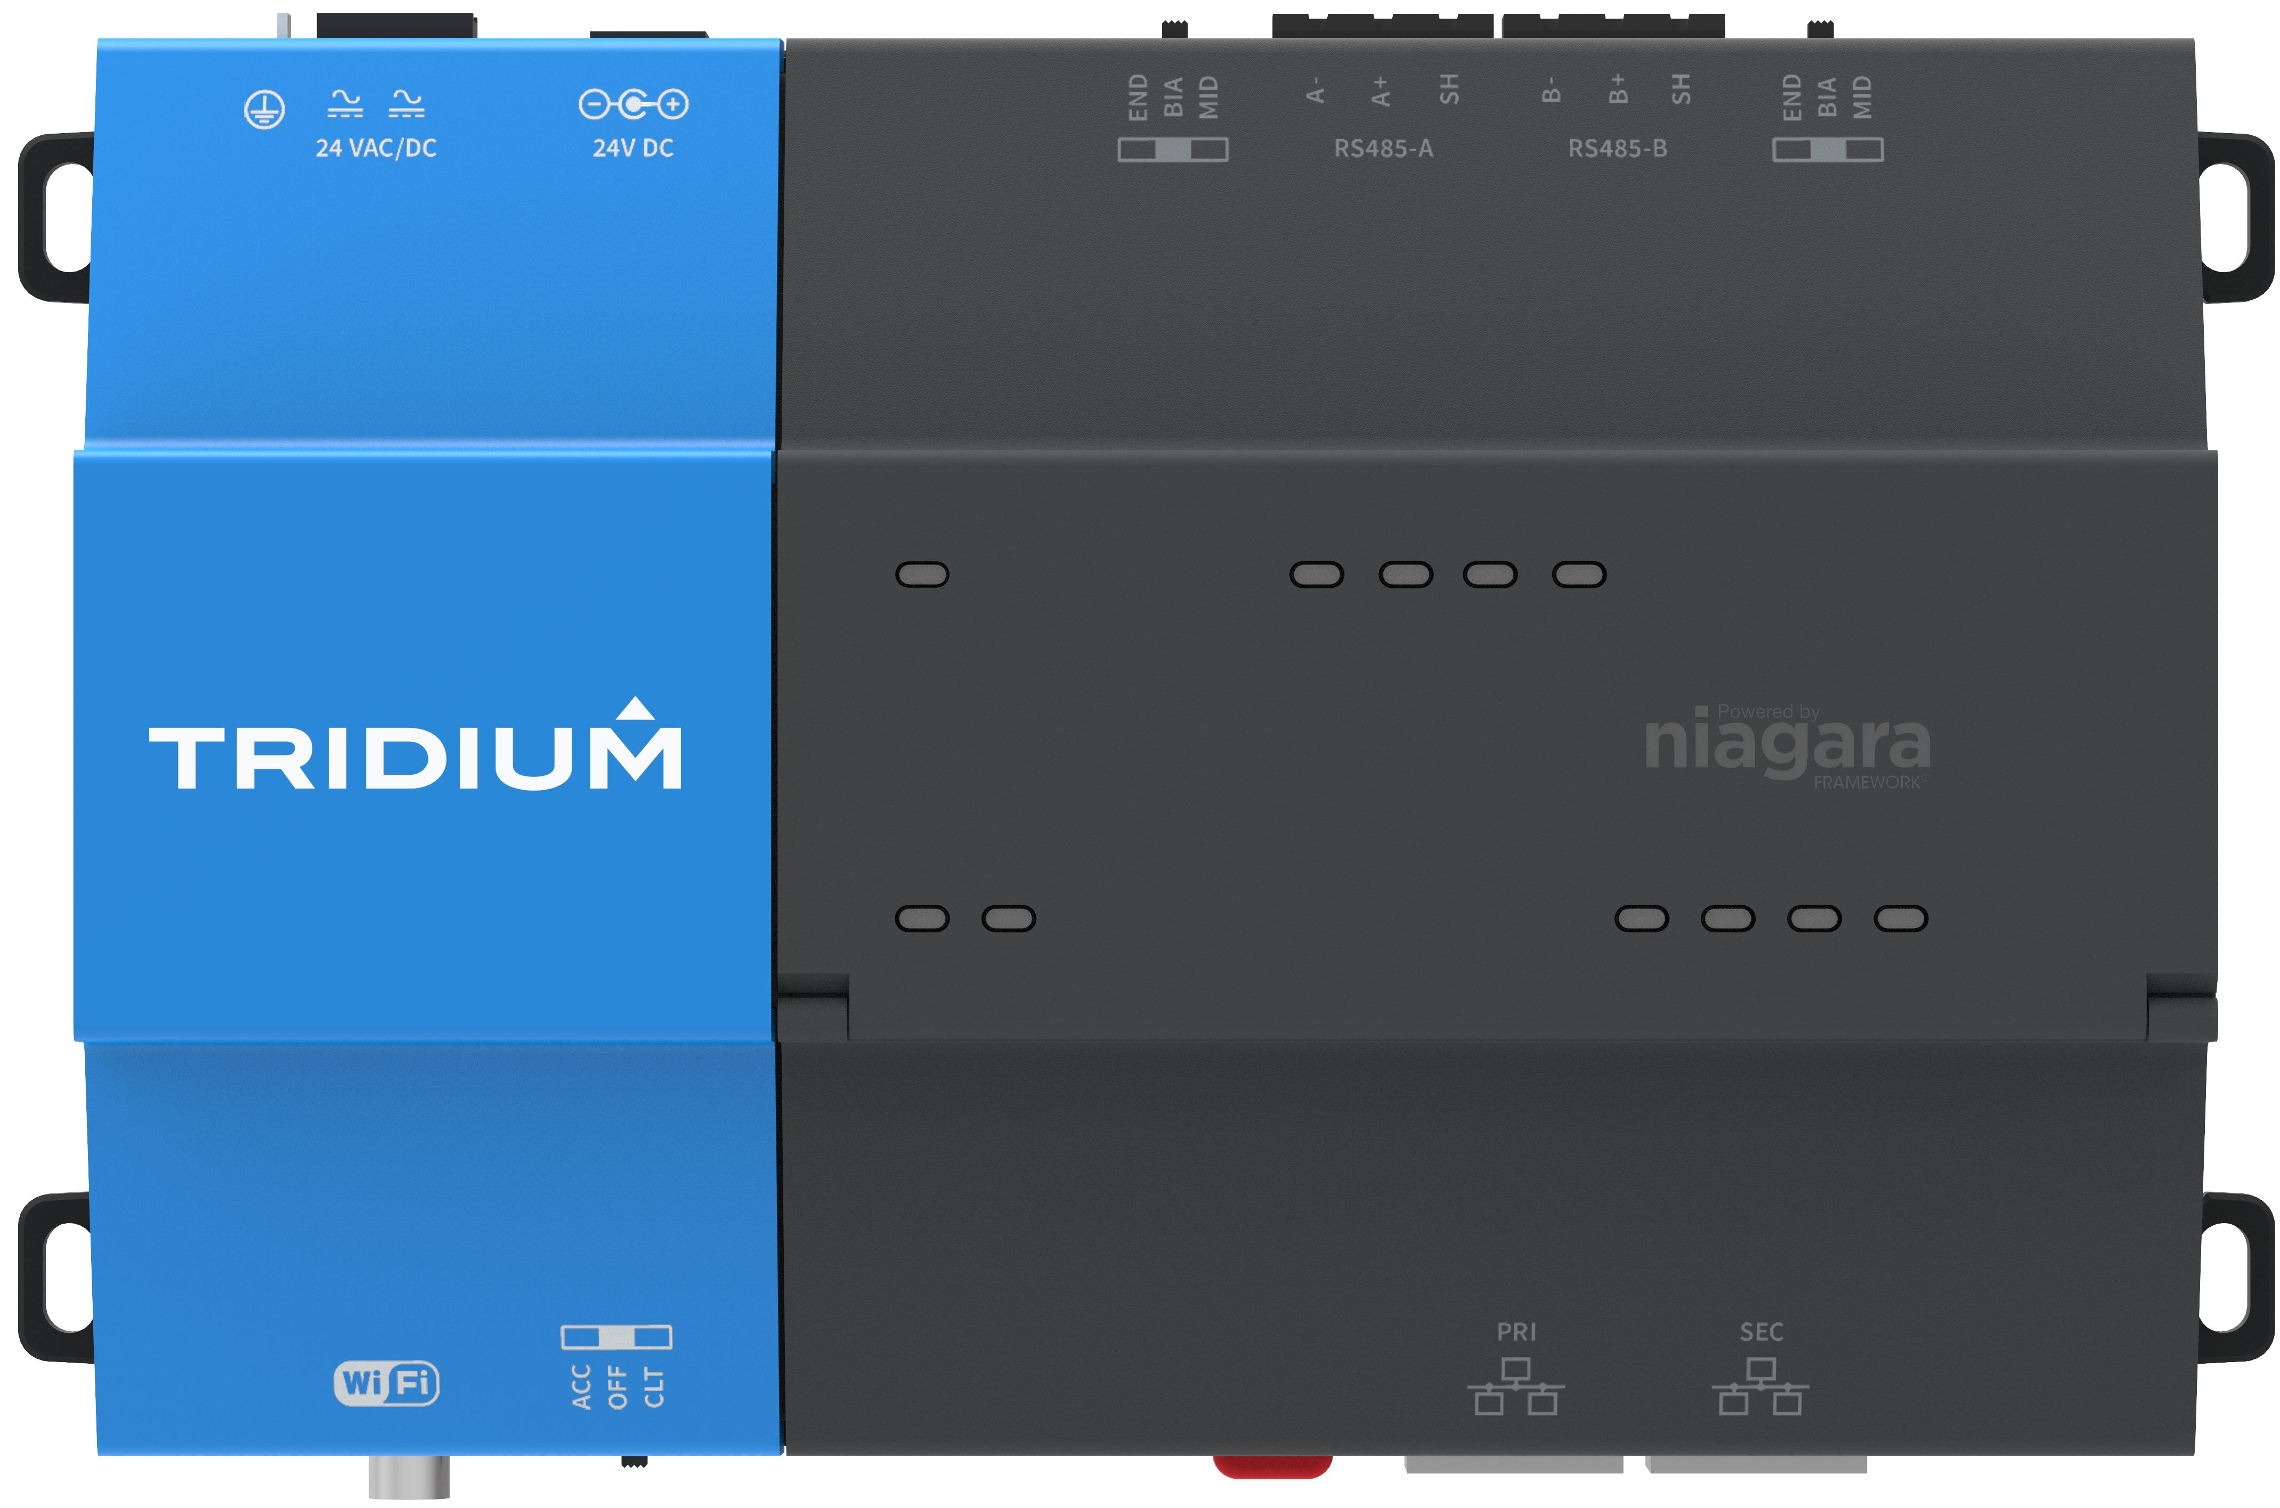
System Database – what is it?
Sup Station
Notes:
We thought that was a great idea, and in turn constructed Edbot (or System DB), the Niagara Supervisor that knows everything.
It all starts with an indexing service, which periodically crawls through the JACE network and pulls in component data. Currently, we recommend indexing once a day.
The System DB/System Indexing feature crawls the JACEs for components and their tags/relations (e.g. networks, devices, points, schedules, etc). While It does not automatically retrieve non-Component information, such as alarms or histories – (those are still configured the way they always have using NiagaraNetwork, but) in many cases, once you set them up, they can seamlessly integrate with the component data retrieved from the System DB. So now you can get access to the networks, devices, points, schedules, etc. (and their px graphics) that span across your entire Niagara system, simply by accessing the supervisor. We do this by using Niagara virtuals when we query the System DB at the supervisor level.
Now with EdBot, the supervisor is now more powerful than ever.
Stop by the booth, and watch the demo in person for building a complete system hierarchy from a multi JACE system in just a few moments.

Slide 31
FIPS 140-2
What is it?
U.S. government computer security standard used to approve cryptographic modules published by the National Institute of Standards and Technology (NIST)
Notes:
Next, it’s not going to be a new Niagara release without a major security addition.
Anyone here working with the GSA, DOD or banks?
NIST published a specification for encryption standards, and we are now happy to say Niagara 4.6 will utilize a FIPS verified module. Keep in mind this is a mandate when working with many government sites now.

Slide 32
YESTERDAY
3rd Party Device to Niagara JACE to Niagara Supervisor
Preliminary offsite work
Onsite work
System Component Design
Component Commissioning
= Integrator
Create each JACE instance
Jace station and Unitary Application in JACE
Unitary
Configuration in JACE
Unitary Commissioning
JACE Application Commissioning
= Installer
Integrator
10 hours
20
hours
63
hours
Cloud Commissioning
125 hours
219 hours
20 hours
Time (hrs.)
50
100
150
200
250
300
350
400
450
500
550
600
0
Installer
Ready for Unitary Installation
System Checkout
Notes:
Now you may not realize it, but you like this slide.
It’s for one of two reasons…
One possibility is it is my last slide?
The other option is it is going to be the coolest thing you’ve ever seen. Before you is a typical break down of the time involved to setup and deploy a controls job. Obviously, it is just an average case, but when you add it up, significant time is spent setting up, installing, commissioning, and getting back off the site.
As part of our edge strategy we’ve come up with new tools that will dramatically reduce the labor needed to setup everything from supervisor down to unitary controllers. However, I can’t steel Brent’s thunder.
With that, I’d like to hand the Mic over to Brent and let him give you an update on all things hardware and introduce our new Edge tools.

Slide 33
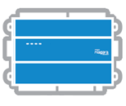
Supervisor
JACE
Portability
Edge 10

Slide 34
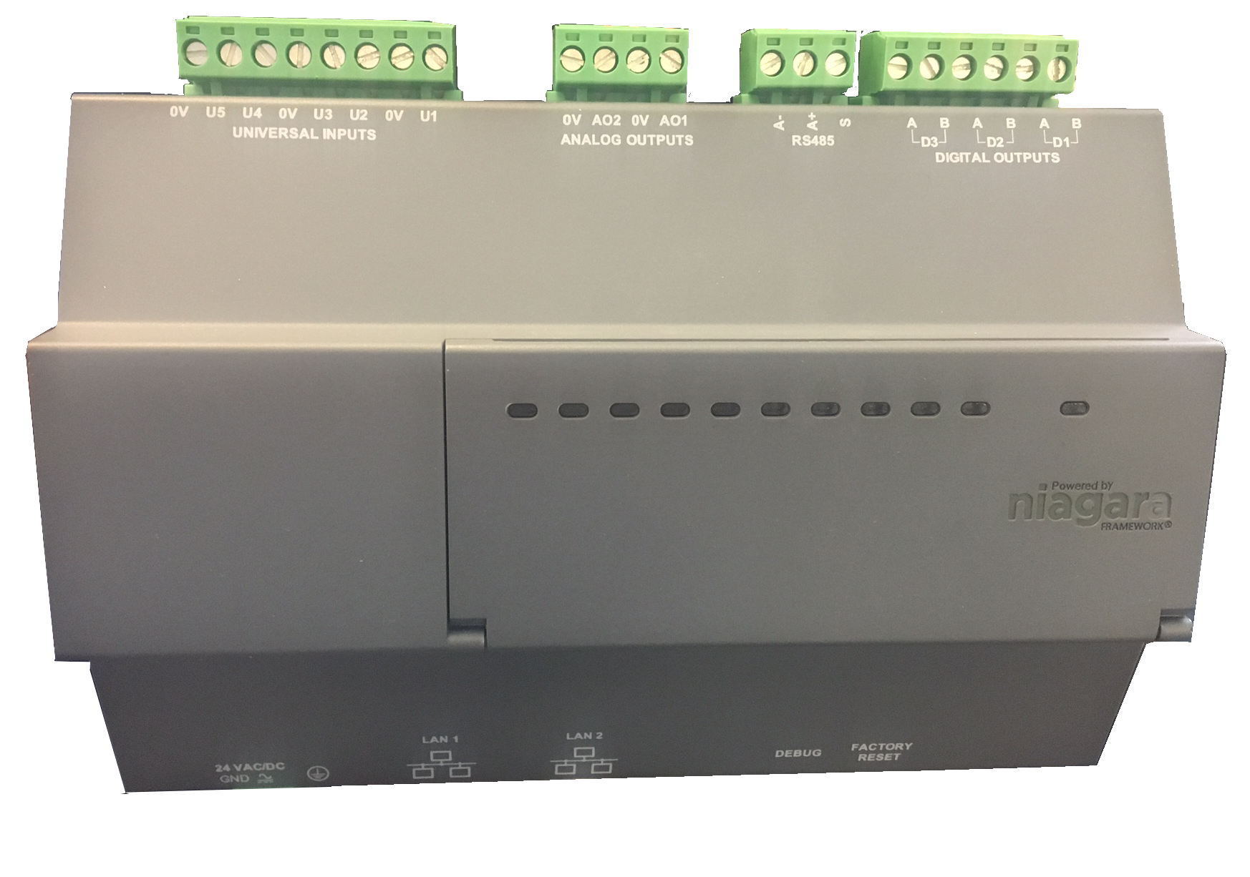
Introducing Niagara Edge 10
IP based general purpose IO Controller
Powered by Niagara Framework
5 UI • 3 DO • 2 AO
1 485 Serial Port
2 Ethernet Ports capable of daisy chaining
Expansion via NRIO 16 and 34
Fan Coil Unit • Single Stage AHU
Water Source HP • Pressure Dep Zone Control
Boiler Hot Water Reset, etc…
Performance & Power
Cybersecurity
Time & Labor Savings
Deterministic Runtime Engine
Built in Niagara Security
Enhanced Niagara workflows
Notes:
Security -> no other IP based building network has the security…

Slide 35
Is this just a JACE?
Feature | JACE | Edge 10
Full Niagara Stack YES YES
Secure IP Stack YES YES
Onboard IO NO YES
Deterministic Runtime Engine NO YES
Daisy Chained Ethernet NO YES
Application Integration Platform Field Controller
Notes:
Daisy chain.. E10 -> has Ethernet that helps ‘continue’ network.. JACE -> expected to work across isolated networks and aggregate data across them.

Slide 36
Introducing Niagara Edge 10
IP based general purpose IO Controller
Powered by Niagara Framework
5 UI • 3 DO • 2 AO
1 485 Serial Port
2 Ethernet Ports capable of daisy chaining
Expansion via NRIO 16 and 34
Fan Coil Unit • Single Stage AHU
Water Source HP • Pressure Dep Zone Control
Boiler Hot Water Reset, etc…
Performance & Power
Cybersecurity
Time & Labor Savings
Deterministic Runtime Engine
Built in Niagara Security
Enhanced Niagara workflows

Slide 37
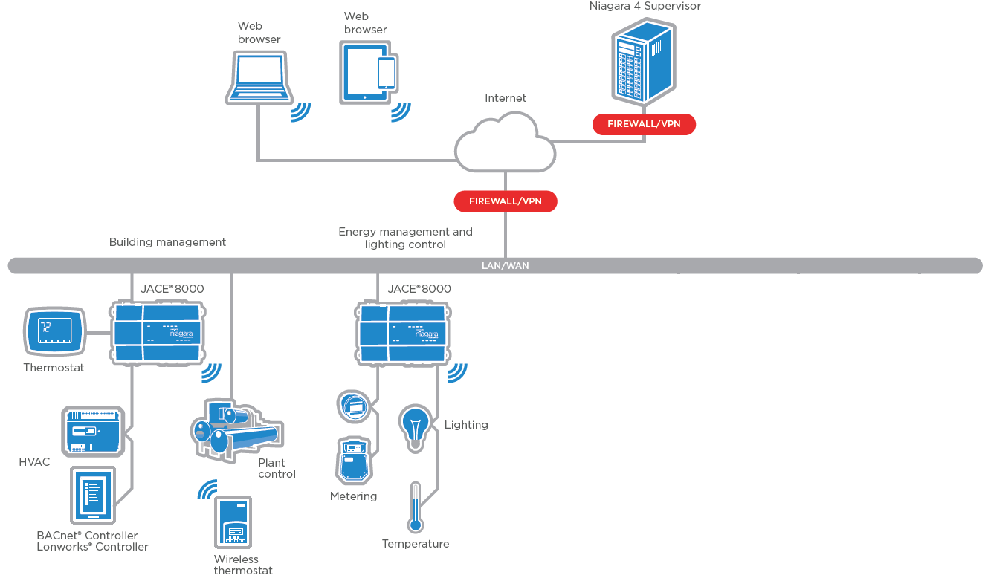
Niagara Edge Tools – Joining the Network

Slide 38
Niagara Edge Tools – Securing Devices

Slide 39
Niagara Edge Tools – Application/Config Deployment

Slide 40
Enhanced Workflows

Slide 41
Enhanced Workflows

Slide 42
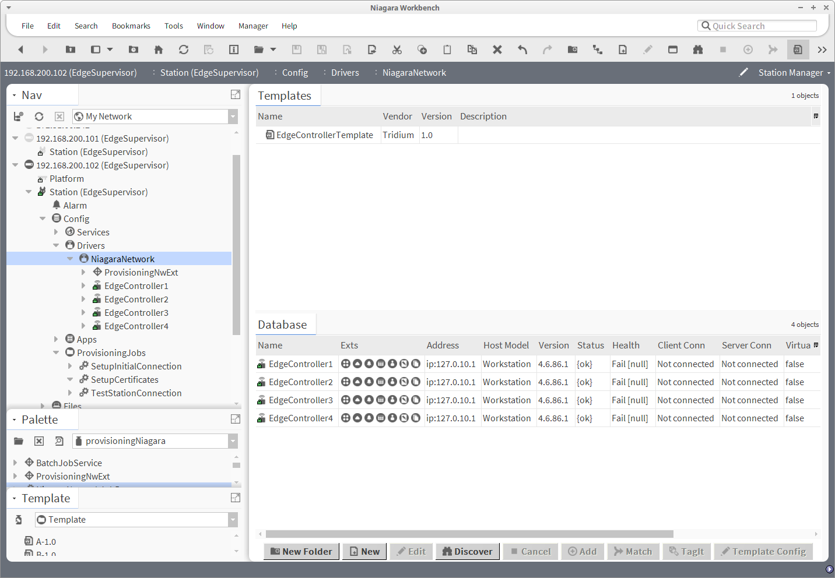
Enhanced Workflows

Slide 43
Enhanced Workflows

Slide 44
Enhanced Workflows

Slide 45
Niagara at the Edge
Single Tool
Time Savings
Efficiency
Security
Notes:
Sell that this is Niagara portability….
Analytics -> automatically invoke rules based on tags to generate alarms and reports.

Slide 46
Introducing Niagara Edge 10
IP based general purpose IO Controller
Powered by Niagara Framework
5 UI • 3 DO • 2 AO
1 485 Serial Port
2 Ethernet Ports capable of daisy chaining
Expansion via NRIO 16 and 34
Fan Coil Unit • Single Stage AHU
Water Source HP • Pressure Dep Zone Control
Boiler Hot Water Reset, etc…
Performance & Power
Cybersecurity
Time & Labor Savings
Deterministic Runtime Engine
Built in Niagara Security
Enhanced Niagara workflows

Slide 47
Supervisor
JACE
Portability
Edge 10

Slide 48
Now or Later?
Release | Availability
Niagara 4.4 (SSO, HTML5 Views, Perf Improvements) | Now
Niagara 4.6 (Mobile, Ed Bot, Tools, FIPS) | Beta
Analytics 2.0 | Now
Analytics 2.1 (New Reports, New Rules) | Beta
BACnet BTWL AWS | Now (As of 4.3)
MQTT, OPC-UA, Profinet (Windows) | Now
EthernetIP | Beta
Edge 10 | Beta

Slide 49
Q&A
Mike Westerfield: mwesterfield@tridium.com
Brent Lowe: brent.lowe@tridium.com

